Slide 1
Data Science in Real Estate

Slide 2
CONTENTS OF THIS TEMPLATE
1.Data Collection
2.Data Preprocessing
3.Feature Engineering
4.Data Analysis

Slide 3
Data Collection
First off all using web scraping I collect data from website which name is bina.az. From this website I extract data such as
price,location,number of rooms, area, floor, time of the announcement.
Note : This data includes only first 50 pages of website.
MYHOME
REAL ESTATE

Slide 4
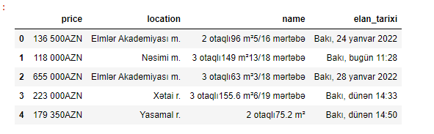
Data Collection

Slide 5
Data Preprocessing
As you can see data is in unsefull format. We need preprocess it. Activitites include changing datatype, separate number of room, floor from the name column, removing character from strings for example removing ‘azn’ from price list because it is numeric data if we don’t remove ‘azn’ we cant use it in data analysis. Also removing null values from dataset.
MYHOME
REAL ESTATE

Slide 6
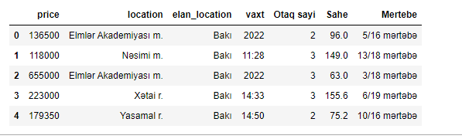
Data Preprocessing

Slide 7
Feature Engineering
From this data we can create new variable such as price of 1 m^2.
MYHOME
REAL ESTATE

Slide 8
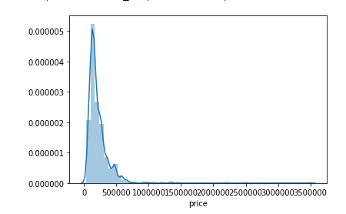
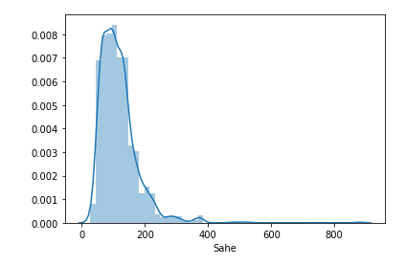
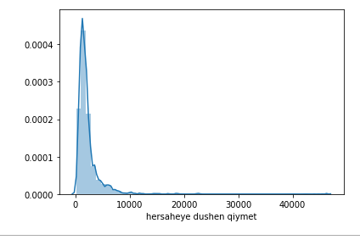
Data Analysis
Distributions of price,area and per price for area

Slide 9
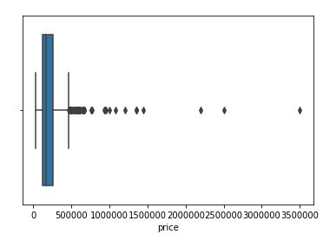
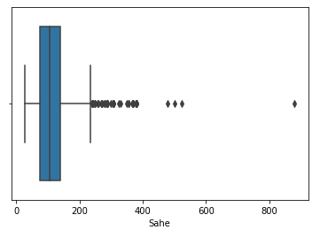
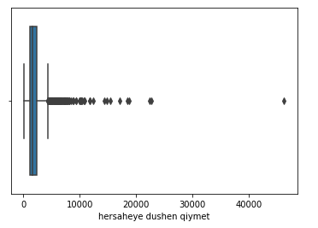
Data Analysis
Analyzing outliers of price,area and per price for area. When creating model we must deal with outliers!

Slide 10
Data Analysis
Analyzing outliers of price,area and per price for area. When creating model we must deal with outliers!

Slide 11
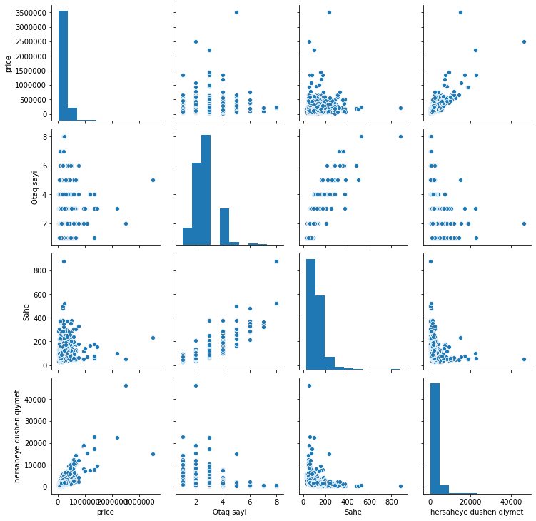
Data Analysis

Slide 12
Thanks!!!

